Slide 1
2.3 Shop Online, NOW!
Ιt’s EASY!
This document was created with the financial support of the European Union. The European Commission's support for the production of this document does not constitute an endorsement of the contents, which reflect the views only of the authors, and the Commission cannot be held responsible for any use which may be made of the information contained therein. Project number: 621403-EPP-1-2020-1-EL-EPPKA3-IPI-SOC-IN

Slide 2
Learning Outcomes
Participants will be introduced to the world of online shopping
and access online shops.

Slide 3
Table of Contents
Presentation of online shopping
Benefits of online sopping
Ready to shop online? Follow the steps!

Slide 4
Presentation of online shopping
The Internet has revolutionized the way we shop.
Because of the numerous advantages and benefits, more and more people these days prefer buying things online over the conventional method of going into stores.

Slide 5
Benefits of online sopping
It is easy. You can shop any time, at home.
Better prices. Cheap deals and better prices are available online, because products come to you direct from the manufacturer or seller without involving middlemen.
More variety. The choices online are amazing.
Sending gifts to relatives and friends is easy, no matter where they are.

Slide 6
More benefits of online shopping
No crowds.
Easy price comparisons. Comparing and researching products and their prices is so much easier online.
No pressure to buy things we don’t need.
You can buy used or damaged items at lower prices.
More control. Online, you don't have to let the store's inventory dictate what you buy, and you can get exactly what you want and need.

Slide 7
Let’s get started!
Ready to shop online?
Follow the steps!

Slide 8
Step 1: Search for a product
Type the name of the item you want to buy into the search box of a search engine, such as Google:
For example, “watches” – and click Search
or press “Go” or “Enter” on your keyboard

Slide 9
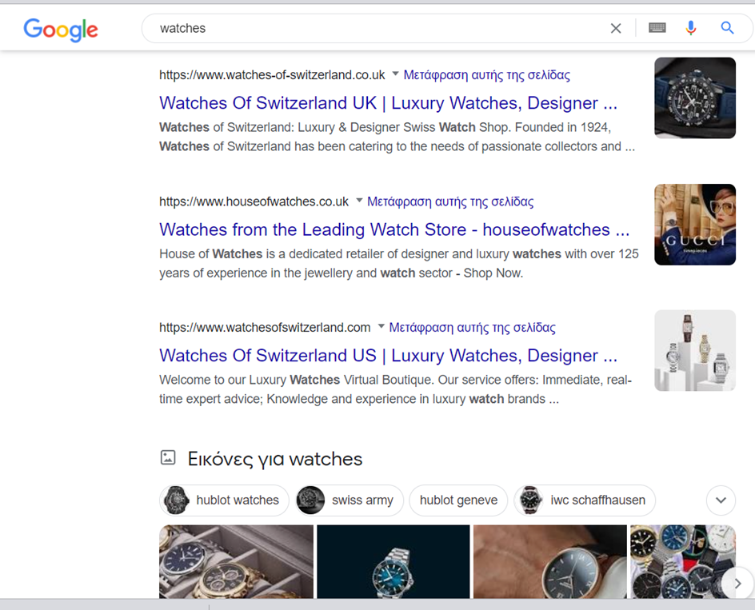
You will see a range of websites, from actual department stores to large websites simply devoted to shopping, such as Amazon or Scroutz

Slide 10
You can also use the Shopping option on Google itself
Clicking on this will give you items available based on product reviews and price. Check it out!

Slide 11
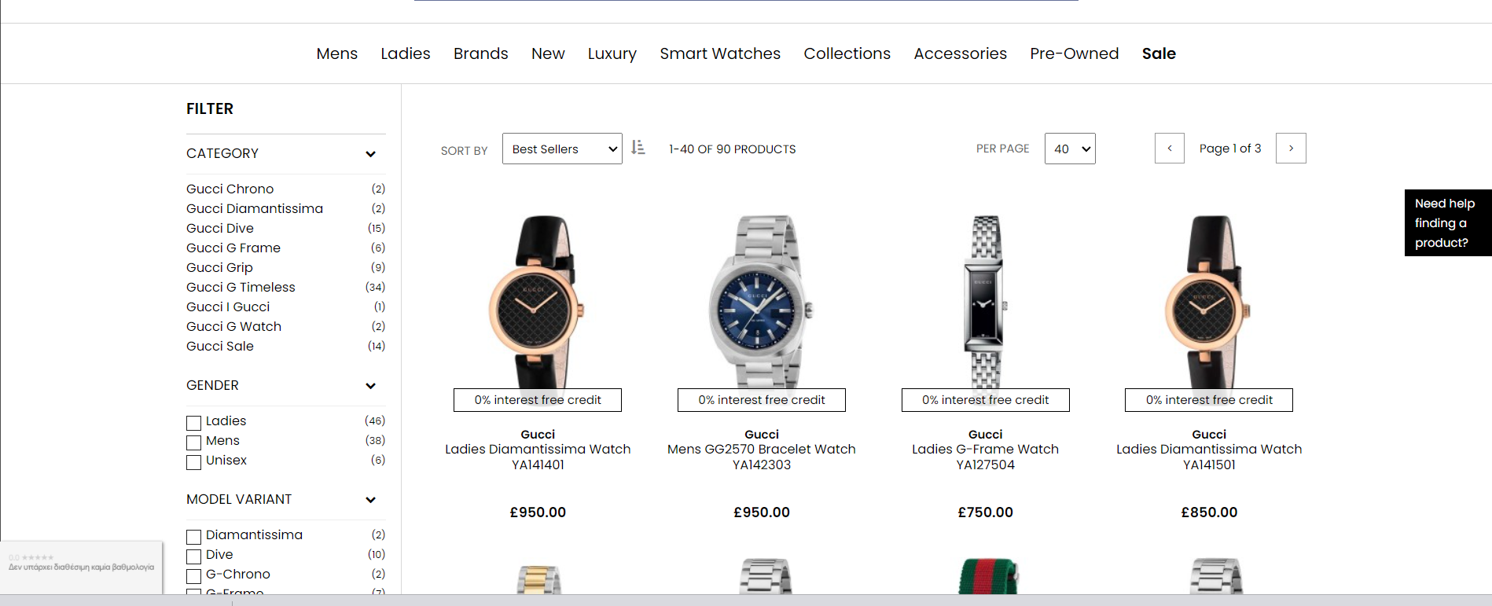
Step 2: Find an item you like using Google shopping
If you click on one of the suggested items you will see the product details
and details of the sellers

Slide 12
Step 3:Choose the quantity that you want

Slide 13
Step 4: Continue shopping or buy your product
Now you can Continue Shopping if you want to buy other items from this website or to click on Go To Cart and pay for the item you have chosen.

Slide 14
Step 5: Checkout and pay
To pay for your item click on the Checkout button.

Slide 15
Step 6: Create an account before you buy

Slide 16
Step 7: Finalize checking out
You will need to complete all the boxes with your information
(such as your email, name and address)
Press “CONTINUE”

Slide 17
Step 8: Choose the way of payment and CONTINUE

Slide 18
Step 9: Insert your credit card details and CONTINUE

Slide 19
Step 10: Insert extra password
You may be asked for another password depending on your bank you will receive on your smart phone
Once you’ve given the right password, your order will go through.
You should receive an email confirming that your order has been received.

Slide 20
Congratulations! You did it!

